Slide 1

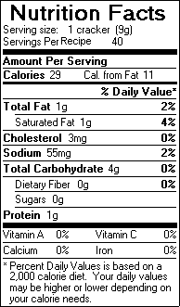
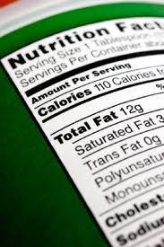
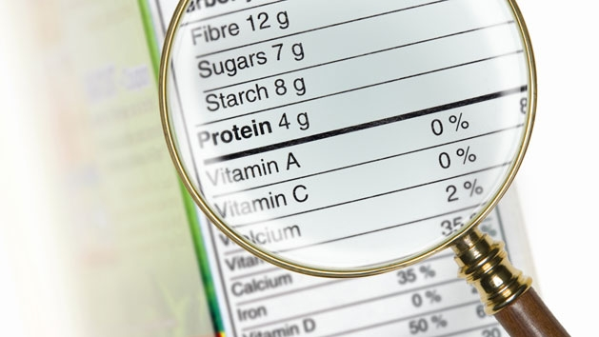
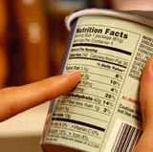
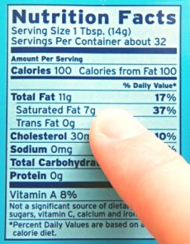
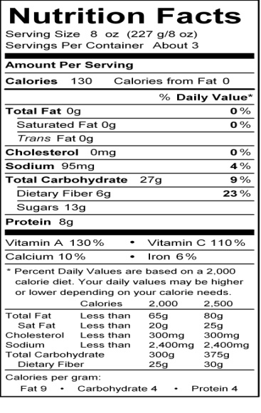
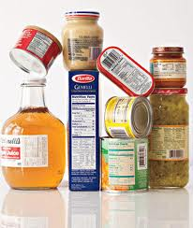
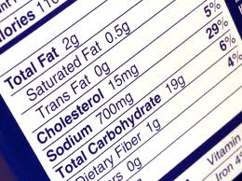
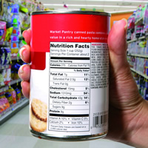
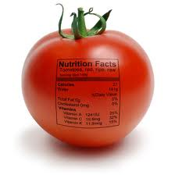
Reading
Food Labels
Click to Begin

Slide 2
Figuring Out
Food Labels
Nutrition Facts
Serving Size 2 Crackers
Servings Per Container About 21
Amount Per Serving
Calories 60 Calories from Fat 15
% Daily Value
Total Fat 1.5 g 2%
Saturated Fat 0g 0%
Trans Fat 0g
Cholesterol 0mg 0%
Sodium 70 mg
Total Carbohydrate 10g 3%
Dietary Fiber Less than 1g 3%
Sugars 0g
Protein 2g
Vitamin A 0% Vitamin C 0%
Calcium 0% Iron 2%
Percent Daily Values are based on a 2,000 calorie diet. Your daily values may be higher or lower depending on your calorie needs:
Calories 2,000 2,500
Total Fat Less than 65g 80g
Sat Fat Less than 20g 25g
Cholesterol Less than 300mg 300mg
Sodium Less than 2400mg 2400mg
Total Carbohydrate 300mg 375g
Dietary Fiber 25g 30g

Slide 3

Nutrition Facts
Serving Size 2 Crackers
Servings Per Container About 21
Nutrition Facts
The Nutrition Facts food label gives you information about which nutrients are in the food
  Your body needs the right combination of nutrients to work properly and grow
The Nutrition Facts food label is printed somewhere on the outside of packaged food, and you usually don't have to look hard to find it
  Fresh food that doesn't come prepackaged sometimes has nutrition facts, too
Amount Per Serving
Calories 60 Calories from Fat 15
% Daily Value
Total Fat 1.5 g 2%
Saturated Fat 0g 0%
Trans Fat 0g
Cholesterol 0mg 0%
Sodium 70 mg
Total Carbohydrate 10g 3%
Dietary Fiber Less than 1g 3%
Sugars 0g
Protein 2g
Vitamin A 0% Vitamin C 0%
Calcium 0% Iron 2%
Percent Daily Values are based on a 2,000 calorie diet. Your daily values may be higher or lower depending on your calorie needs:
Calories 2,000 2,500
Total Fat Less than 65g 80g
Sat Fat Less than 20g 25g
Cholesterol Less than 300mg 300mg
Sodium Less than 2400mg 2400mg
Total Carbohydrate 300mg 375g
Dietary Fiber 25g 30g
More Information

Slide 4
How do they measure each nutrient?
GRAMS
Most nutrients are measured in grams, also written as g
Nutrition Facts
Serving Size 2 Crackers
Servings Per Container About 21
Amount Per Serving
Calories 60 Calories from Fat 15
MILLIGRAMS
Some nutrients are measured in milligrams, or mg
Milligrams are very tiny
There are 1,000 milligrams in 1 gram
% Daily Value
PERCENTAGES
Other information on the label is given in percentages
  Nutrition specialists know how much kids and adults should get every day to have a healthy diet. The percent daily value on a food label tells you how this food can help someone meet these daily goals
Total Fat 1.5 g 2%
Saturated Fat 0g 0%
Trans Fat 0g
Cholesterol 0mg 0%
Sodium 70 mg
Total Carbohydrate 10g 3%
Dietary Fiber Less than 1g 3%
Sugars 0g
Protein 2g
Vitamin A 0% Vitamin C 0%
Calcium 0% Iron 2%
Percent Daily Values are based on a 2,000 calorie diet. Your daily values may be higher or lower depending on your calorie needs:
Calories 2,000 2,500
Total Fat Less than 65g 80g
Sat Fat Less than 20g 25g
Cholesterol Less than 300mg 300mg
Sodium Less than 2400mg 2400mg
Total Carbohydrate 300mg 375g
Dietary Fiber 25g 30g
Main Page

Slide 5
Serving Size
Nutrition Facts
Serving Size 2 Crackers
Servings Per Container About 21
Always lists a serving size, which is an amount of food, such as 1 cup of cereal, two cookies, or five pretzels
The nutrition label tells you how many nutrients are in that amount of food
Serving sizes also help people understand how much they're eating
→ If you ate 4 crackers, that would be two servings.
Amount Per Serving
Calories 60 Calories from Fat 15
% Daily Value
Total Fat 1.5 g 2%
Saturated Fat 0g 0%
Trans Fat 0g
Cholesterol 0mg 0%
Sodium 70 mg
Total Carbohydrate 10g 3%
Dietary Fiber Less than 1g 3%
Sugars 0g
Serving Per Container
Protein 2g
Vitamin A 0% Vitamin C 0%
Calcium 0% Iron 2%
Percent Daily Values are based on a 2,000 calorie diet. Your daily values may be higher or lower depending on your calorie needs:
Calories 2,000 2,500
Total Fat Less than 65g 80g
Sat Fat Less than 20g 25g
Cholesterol Less than 300mg 300mg
Sodium Less than 2400mg 2400mg
Total Carbohydrate 300mg 375g
Dietary Fiber 25g 30g
The label tells you how many servings are contained in that package of food
How many servings in this package?
About 42
Main Page

Slide 6
Calories
Nutrition Facts
Serving Size 2 Crackers
Servings Per Container About 21
Main Page
The number of calories in a single serving of the food is listed on the left of the label
This number tells you the amount of energy in the food
The calories in a food can come from fat, protein, or carbohydrate
People pay attention to calories because if you eat more calories than your body uses, you might gain weight
Amount Per Serving
Calories 60 Calories from Fat 15
% Daily Value
Total Fat 1.5 g 2%
Saturated Fat 0g 0%
Trans Fat 0g
Number of calories that come from fat
Limit fat intake to about 30% of the calories they eat daily
Cholesterol 0mg 0%
Sodium 70 mg
Total Carbohydrate 10g 3%
Dietary Fiber Less than 1g 3%
Sugars 0g
Protein 2g
Vitamin A 0% Vitamin C 0%
Calcium 0% Iron 2%
Percent Daily Values are based on a 2,000 calorie diet. Your daily values may be higher or lower depending on your calorie needs:
Calories 2,000 2,500
Total Fat Less than 65g 80g
Sat Fat Less than 20g 25g
Cholesterol Less than 300mg 300mg
Sodium Less than 2400mg 2400mg
Total Carbohydrate 300mg 375g
Dietary Fiber 25g 30g
Calories
from Fat

Slide 7
Total Fat
Nutrition Facts
Serving Size 2 Crackers
Servings Per Container About 21
Amount Per Serving
Calories 60 Calories from Fat 15
Number of fat grams contained in one serving of the food
Fat is an important nutrient that your body uses for growth and development, but you don't want to eat too much
The different types of fat are listed too
Unsaturated Fat
Saturated Fat
Trans Fat
% Daily Value
Total Fat 1.5 g 2%
Saturated Fat 0g 0%
Trans Fat 0g
Cholesterol 0mg 0%
Sodium 70 mg
Total Carbohydrate 10g 3%
Dietary Fiber Less than 1g 3%
Sugars 0g
Protein 2g
Vitamin A 0% Vitamin C 0%
Calcium 0% Iron 2%
Percent Daily Values are based on a 2,000 calorie diet. Your daily values may be higher or lower depending on your calorie needs:
Calories 2,000 2,500
Total Fat Less than 65g 80g
Sat Fat Less than 20g 25g
Cholesterol Less than 300mg 300mg
Sodium Less than 2400mg 2400mg
Total Carbohydrate 300mg 375g
Dietary Fiber 25g 30g
Main Page

Slide 8
Nutrition Facts
Cholesterol
Serving Size 2 Crackers
Servings Per Container About 21
Fat-like substance
Used for:
Digesting fat
Making Vitamin D
Building cells
Making some hormones
Amount Per Serving
Calories 60 Calories from Fat 15
% Daily Value
Cholesterol 0mg 0%
Sodium 70 mg
Total Carbohydrate 10g 3%
Dietary Fiber Less than 1g 3%
Sugars 0g
Protein 2g
Vitamin A 0% Vitamin C 0%
Calcium 0% Iron 2%
Percent Daily Values are based on a 2,000 calorie diet. Your daily values may be higher or lower depending on your calorie needs:
Calories 2,000 2,500
Total Fat Less than 65g 80g
Sat Fat Less than 20g 25g
Cholesterol Less than 300mg 300mg
Sodium Less than 2400mg 2400mg
Total Carbohydrate 300mg 375g
Dietary Fiber 25g 30g
Main Page

Slide 9
Nutrition Facts
Serving Size 2 Crackers
Servings Per Container About 21
Sodium
Amount Per Serving
Calories 60 Calories from Fat 15
% Daily Value
Total Fat 1.5 g 2%
Saturated Fat 0g 0%
Trans Fat 0g
Proper sodium nutrition can help in the regulation of blood pressure, building strong bones, making the required hormones, transmitting nerve impulses correctly and regularizing the heartbeat
Cholesterol 0mg 0%
Sodium 70 mg
Total Carbohydrate 10g 3%
Dietary Fiber Less than 1g 3%
Sugars 0g
Protein 2g
Vitamin A 0% Vitamin C 0%
Calcium 0% Iron 2%
Percent Daily Values are based on a 2,000 calorie diet. Your daily values may be higher or lower depending on your calorie needs:
Calories 2,000 2,500
Total Fat Less than 65g 80g
Sat Fat Less than 20g 25g
Cholesterol Less than 300mg 300mg
Sodium Less than 2400mg 2400mg
Total Carbohydrate 300mg 375g
Dietary Fiber 25g 30g
Aim to eat less than 1,500 mg of sodium per day.
Main Page

Slide 10
Carbohydrates
Nutrition Facts
Serving Size 2 Crackers
Servings Per Container About 21
Body's primary source of energy
    This total is broken down into grams of sugar and grams of dietary fiber
Amount Per Serving
Calories 60 Calories from Fat 15
% Daily Value
Total Fat 1.5 g 2%
Saturated Fat 0g 0%
Trans Fat 0g
Cholesterol 0mg 0%
Sodium 70 mg
Total Carbohydrate 10g 3%
Dietary Fiber Less than 1g 3%
Sugars 0g
Protein 2g
Vitamin A 0% Vitamin C 0%
Calcium 0% Iron 2%
Percent Daily Values are based on a 2,000 calorie diet. Your daily values may be higher or lower depending on your calorie needs:
Calories 2,000 2,500
Total Fat Less than 65g 80g
Sat Fat Less than 20g 25g
Cholesterol Less than 300mg 300mg
Sodium Less than 2400mg 2400mg
Total Carbohydrate 300mg 375g
Dietary Fiber 25g 30g
Main Page

Slide 11
Nutrition Facts
Main Page
Serving Size 2 Crackers
Servings Per Container About 21
Amount Per Serving
Calories 60 Calories from Fat 15
% Daily Value
Total Fat 1.5 g 2%
Saturated Fat 0g 0%
Trans Fat 0g
Your body needs protein to build and repair essential parts of the body
→Muscles
→Blood
→Organs
Cholesterol 0mg 0%
Sodium 70 mg
Total Carbohydrate 10g 3%
Dietary Fiber Less than 1g 3%
Sugars 0g
Protein 2g
Vitamin A 0% Vitamin C 0%
Calcium 0% Iron 2%
Percent Daily Values are based on a 2,000 calorie diet. Your daily values may be higher or lower depending on your calorie needs:
Calories 2,000 2,500
Total Fat Less than 65g 80g
Sat Fat Less than 20g 25g
Cholesterol Less than 300mg 300mg
Sodium Less than 2400mg 2400mg
Total Carbohydrate 300mg 375g
Dietary Fiber 25g 30g
Proteins

Slide 12
Two categories:
Fat soluble
A, D, E, and K — Dissolve in fat and can be stored in your body
Water-soluble
C and the B-complex vitamins (such as vitamins B6, B12, niacin, riboflavin, and folate)
Need to dissolve in water before your body can absorb them. Because of this, your body can't store these vitamins.
NOTE: Any vitamin C or B that your body doesn't use as it passes through your system is lost (mostly when you go to the bathroom). So you need a fresh supply of these vitamins every day.
Minerals
Nutrition Facts
Serving Size 2 Crackers
Servings Per Container About 21
Amount Per Serving
Inorganic elements that come from the soil and water and are absorbed by plants or eaten by animals
Your body needs larger amounts of some minerals, such as calcium, to grow and stay healthy
Other minerals are called trace minerals because you only need very small amounts of them each day.
Calories 60 Calories from Fat 15
% Daily Value
Total Fat 1.5 g 2%
Saturated Fat 0g 0%
Trans Fat 0g
Cholesterol 0mg 0%
Sodium 70 mg
Total Carbohydrate 10g 3%
Dietary Fiber Less than 1g 3%
Sugars 0g
Protein 2g
Vitamin A 0% Vitamin C 0%
Calcium 0% Iron 2%
Percent Daily Values are based on a 2,000 calorie diet. Your daily values may be higher or lower depending on your calorie needs:
Calories 2,000 2,500
Total Fat Less than 65g 80g
Sat Fat Less than 20g 25g
Cholesterol Less than 300mg 300mg
Sodium Less than 2400mg 2400mg
Total Carbohydrate 300mg 375g
Dietary Fiber 25g 30g
Vitamins
More Information

Slide 13
Nutrition Facts
Serving Size 2 Crackers
Servings Per Container About 21
On food labels, they base the percentages on a 2,000-calorie adult diet
Amount Per Serving
Calories 60 Calories from Fat 15
% Daily Value
Total Fat 1.5 g 2%
Saturated Fat 0g 0%
Trans Fat 0g
The ingredient list is usually listed below this section
Ingredients are listed in order of weight
Check ingredient lists to see where sugar appears
→Limit foods that mention sugar in the first few ingredients. That means it's a very sugary food. Sugar has different names, so it might also be called high fructose corn syrup, corn syrup, sucrose, or glucose.
Cholesterol 0mg 0%
Sodium 70 mg
Total Carbohydrate 10g 3%
Dietary Fiber Less than 1g 3%
Sugars 0g
Protein 2g
Vitamin A 0% Vitamin C 0%
Calcium 0% Iron 2%
Percent Daily Values are based on a 2,000 calorie diet. Your daily values may be higher or lower depending on your calorie needs:
Calories 2,000 2,500
Total Fat Less than 65g 80g
Sat Fat Less than 20g 25g
Cholesterol Less than 300mg 300mg
Sodium Less than 2400mg 2400mg
Total Carbohydrate 300mg 375g
Dietary Fiber 25g 30g
Main Page

